Slide 1
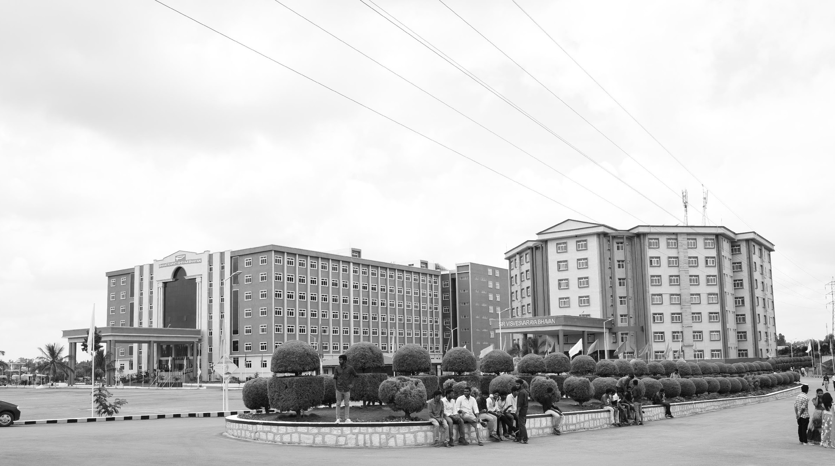

Development of Drone for Emergency Services
Mid-Review 1
Major Project
Project ID: CS17
AY 2021-25
GITAM (Deemed-to-be) University
Project Team:
Jagannath Sagar Karri
Palakonda Visweswara Rao
Department of Electrical Electronics and Communication Engineering
Project Mentor:
Sanhita Manna
Project In-charge:
Dr.Pankaj Kandhway
www.gitam.edu

Slide 2
Problem Statement
Objective
Objective: The project addresses the need for advanced tools to enhance the efficiency of emergency response services, focusing on a drone designed for reconnaissance and support in disaster-affected areas. The drone will provide real-time situational awareness to emergency responders, reducing response times and improving decision-making
Develop a drone capable of providing real-time aerial reconnaissance to emergency services.
Assist emergency response teams in disaster-stricken areas by offering live video feeds, enhancing situational awareness.
Goals
Main Goals
Optimize the drone’s flight efficiency, communication range, and operational capabilities for seamless real-time data transmission.
Ensure ease of deployment and autonomous flight capabilities, minimizing the need for manual intervention during critical operations.
Integrate the drone with existing emergency response systems to improve coordination and effectiveness in rescue operations.

Slide 3
20 days
5 days
5 days
5 days
5 days
5 days
5 days
5 days
5 days
5 days
5 days
5 days
5 days
2024
Project Plan
Today
Sep
Oct
Nov
Dec
2024
Sep 1 - Sep 8
Initial Research and Requirement Gathering
Research and Design
Sep 8 - Sep 15
System Architecture Design
Sep 15 - Sep 22
Component Selection and Prototyping
Sep 22 - Oct 20
Integration of Imaging and Communication Systems
Development
Oct 20 - Oct 27
System Integration Testing
Oct 27 - Nov 3
Detailed Performance Testing
Testing and Validation
Nov 3 - Nov 10
Detailed Performance Testing
Nov 10 - Nov 17
Iterative Improvements
Nov 17 - Nov 24
Final Validation Testing
Nov 24 - Dec 1
Preparation for Deployment
Deployment and Documentation
Dec 1 - Dec 8
Preparation for Deployment
Dec 8 - Dec 15
Project Documentation
Dec 15 - Dec 22
Presentation and Project Handover

Slide 4
Literature Survey
Key Publications
APPLICATIONS OF UNMANNED AERIAL VEHICLES: A REVIEW
http://dx.doi.org/10.17993/3ctecno.2019.specialissue3.85-105
A review of UAV autonomous navigation in GPS-denied environments
https://doi.org/10.1016/j.robot.2023.104533
Reliable Flying IoT Networks for UAV Disaster Rescue Operations
https://doi.org/10.1155/2018/2572460
UAV- based Photogrammetry and Geo-computing for Hazards and Disaster Risk Monitoring – A Review
https://doi.org/10.1186/s40677-016-0060-y
Key Resources – Whitepaper| Application Notes | Datasheet | Others
Component: Ublox NEO-M8N GPS Module Datasheet
Component: Sharp GP2Y0A21YK0F Analog Distance Sensor Datasheet
Component: HC-SR04 Ultrasonic Distance Sensor datasheet
Existing Implementations – Products| Opensource| GitHub etc
Aerial Drones for Fire Disaster Response
10.5772/intechopen.1002525
DJI ENTERPRISE – Fire fighting
https://enterprise.dji.com/public-safety/firefightingFirefighting
https://docs.holybro.com/autopilot/pixhawk-6c
Flight Controller Complete Documentation

Slide 5
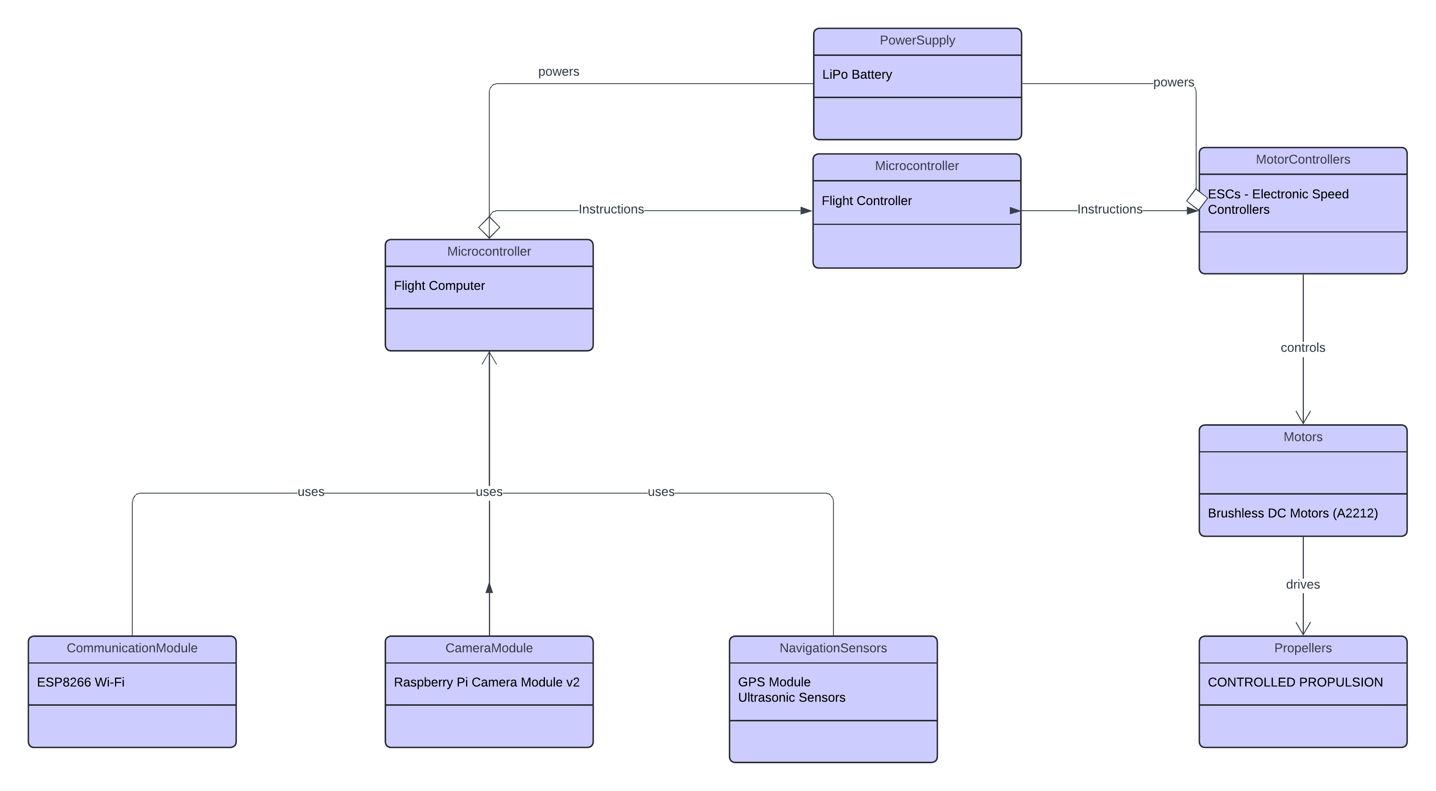
Architecture
Structural Diagram & Behaviour Diagram
Pixhawk 6C
Pixhawk 6C
Neo – 7M GPS Accelerometers
Gyroscopes
Compass
3dr Radio Telemetry
Drone FPV Camera

Slide 6
LIST OF COMPONENTS AND THEIR PURPOSE

Slide 7
Use Cases & Testing
Use Cases
Scenario 1: Urban Disaster Site Monitoring: The drone flies over a collapsed building, providing real-time images and thermal scans to locate trapped victims.
Scenario 2: Remote Area Surveillance: In a wildfire scenario, the drone captures high-resolution footage to map fire spread and help direct firefighting efforts.
Scenario 3: Hazardous Environment Assessment: The drone assesses a chemical spill site, providing situational awareness without exposing responders to toxic conditions.
Test Cases
Verify the effectiveness of autonomous navigation in different terrains
.
Test the range and reliability of real-time data transmission under various network conditions.
Evaluate the drone’s durability and performance in harsh environmental conditions (e.g, wind)

Slide 8
Implementation and Results – Iteration 1
1. Hardware Integration Challenges
One of the primary challenges faced during the project was the integration of multiple hardware components, such as the flight controller, GPS module, motors, and communication module. Ensuring seamless communication between these components while maintaining stability was a complex task.
Solution: To address this, we carefully followed manufacturer guidelines for wiring and connectivity. Thorough calibration procedures were conducted, and multiple test flights were performed to fine-tune the system. Additionally, software debugging was carried out to resolve communication protocol mismatches.
2. Real-Time Video Transmission Issues
The drone was designed to provide live aerial footage, but achieving a stable and low-latency video transmission proved difficult due to bandwidth limitations and environmental interference.
Solution: We optimized the transmission protocol by selecting an appropriate frequency band and using error-correction techniques to minimize data loss. A high-gain antenna was also used to enhance the range and signal strength.
3. Flight Stability and Navigation Accuracy
Initial test flights showed instability, especially in high-wind conditions. The drone's navigation system also experienced occasional drift due to GPS inaccuracies.
Solution: We implemented sensor fusion techniques by integrating data from the IMU (Inertial Measurement Unit) and GPS module to improve stability and navigation accuracy. Fine-tuning the PID (Proportional-Integral-Derivative) controller in the flight control algorithm further enhanced maneuverability.

Slide 9
Implementation and Results – Iteration 1
4. Battery Life and Power Management
The drone’s operational time was limited due to high power consumption, which posed a challenge for long-duration reconnaissance missions.
Solution: A power-efficient flight path was designed to minimize unnecessary energy expenditure. Additionally, a high-capacity LiPo battery was chosen, and a dynamic power management system was implemented to distribute power efficiently among various subsystems.
These solutions collectively ensured that the emergency support drone met the required performance standards and provided reliable reconnaissance during disaster scenarios

Slide 10
Implementation and Results – Iteration 2
1. Flight Performance and Stability
The drone exhibited stable flight performance during test trials, successfully maneuvering in both open and obstacle-rich environments. The implementation of sensor fusion techniques and PID tuning enhanced flight stability, ensuring smooth navigation and minimal drift.
2. Video Transmission and Data Processing
Real-time video transmission was achieved with minimal latency, allowing emergency teams to receive live footage without significant delays. The implementation of a high-gain antenna and optimized transmission protocols ensured reliable communication over long distances.
3. Autonomous Navigation and Obstacle Avoidance
The drone was able to follow predefined flight paths autonomously and demonstrated effective obstacle avoidance capabilities using onboard sensors. Path-planning algorithms helped optimize flight routes for efficient coverage of disaster zones.
4. Battery Performance and Flight Duration
Power management optimizations resulted in extended flight time, allowing the drone to operate for longer durations without frequent battery replacements. This ensured that the drone could cover larger areas without interruption.
Overall, the project demonstrated the feasibility of deploying an emergency support drone for disaster response, highlighting its potential to significantly enhance emergency management and rescue operations.

Slide 11
Contribution
Team Progress and Movement
Jagannath Sagar – Team Lead
Palakonda Visweswara Rao - Hardware
Individual Contribution
Key contributions: Jagannath Sagar
Drone Assembly
Flight Control Systems
Camera Integration
Telemetry Configuration
Autopilot integration
Key contributions: Palakonda Visweswara Rao
Radio systems calibration
Power system setup

Slide 12
Conclusion & Future Work
Summary and Conclusion
The development of the emergency support drone has demonstrated the potential of UAV technology in disaster response and emergency services. The project successfully addressed key challenges in reconnaissance, real-time video transmission, and autonomous navigation, making it a viable tool for enhancing situational awareness during natural disasters and accidents.
The key conclusions drawn from this project include:
Rapid Deployment Capability: The drone can be deployed quickly in emergency situations, providing crucial reconnaissance in the early stages of disaster response.
Enhanced Situational Awareness: Real-time video streaming enables emergency teams to assess damage, locate victims, and coordinate rescue efforts efficiently.
Autonomous and Reliable Operation: The integration of GPS-based navigation, sensor fusion, and obstacle avoidance ensures stable and autonomous flight, reducing the need for manual intervention.
Optimized Power Management: Energy-efficient flight paths and battery optimizations allow for extended operation, increasing the effectiveness of reconnaissance missions.
Despite the challenges faced, the project successfully achieved its goals, proving that drones can serve as valuable assets in emergency management. Future advancements can further refine the system to make it even more effective for real-world deployment.

Slide 13
Conclusion & Future Work
FUTURE WORK
While the emergency support drone demonstrated strong performance in its current state, there are several areas for further improvement and expansion to enhance its capabilities.
1. AI-Powered Disaster Assessment
Incorporating artificial intelligence (AI) for automated hazard detection and victim identification would improve the drone’s effectiveness. Machine learning algorithms could analyze video footage to detect collapsed buildings, fires, or stranded individuals, enabling faster response.
2. Improved Power Management and Flight Duration
Future versions of the drone could utilize advanced battery technologies, such as hydrogen fuel cells or solar-powered charging, to further extend flight time. Additionally, energy-efficient flight planning algorithms could optimize battery consumption.
3. Integration with 5G Networks
The implementation of 5G technology would significantly enhance data transmission speeds, reducing latency and improving the reliability of live video streaming. This would allow emergency teams to receive high-quality footage in real-time, even in remote areas.
4. Enhanced Environmental Adaptability
Future iterations of the drone could incorporate weather-resistant materials and adaptive flight control systems to improve performance in harsh conditions such as heavy rain, strong winds, or extreme temperatures.
5. Multi-Drone Coordination
A swarm of coordinated drones could be deployed simultaneously for large-scale disaster monitoring. Swarm intelligence algorithms would allow multiple UAVs to cover vast areas, share data in real-time, and improve overall efficiency in reconnaissance operations.
By addressing these future advancements, the emergency support drone can evolve into a more powerful tool for disaster response, further aiding emergency services in life-saving operations.

Slide 14
REFERENCES:
• "Applications of Drone in Disaster Management: A Scoping Review"
DOI: 10.1016/j.ijdrr.2021.102133
Link: https://www.sciencedirect.com/science/article/pii/S1355030621001477
• "The Role of Drones in Disaster Response: A Literature Review of Drone Deployments and Future Research Directions"
DOI: 10.1111/itor.13484
Link: https://onlinelibrary.wiley.com/doi/10.1111/itor.13484
• "Drone Applications for Emergency and Urgent Care: A Systematic Review"
DOI: 10.3390/ijerph191610031
Link: https://www.mdpi.com/1660-4601/19/16/10031
• "Integrating Drones in Response to Public Health Emergencies"
DOI: 10.1016/j.jnma.2022.09.246
Link: https://www.sciencedirect.com/science/article/pii/S2590607622002855
• "Using Drones in Planning Practice"
DOI: Not available
Link: https://www.planning.org/publications/report/9207028/
• "Drone as First Responder: Revolutionizing Emergency Response"
DOI: Not available
Link: https://www.thedroneu.com/blog/drone-as-first-responder/

Slide 15
THANK YOU
JAGANNATH SAGAR
PALAKONDA VISWESWARA RAO

